Slide 1
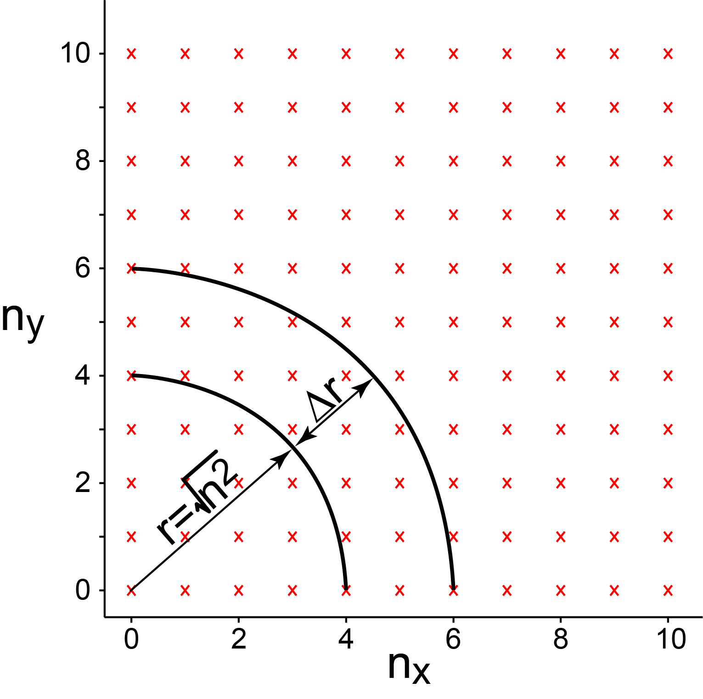
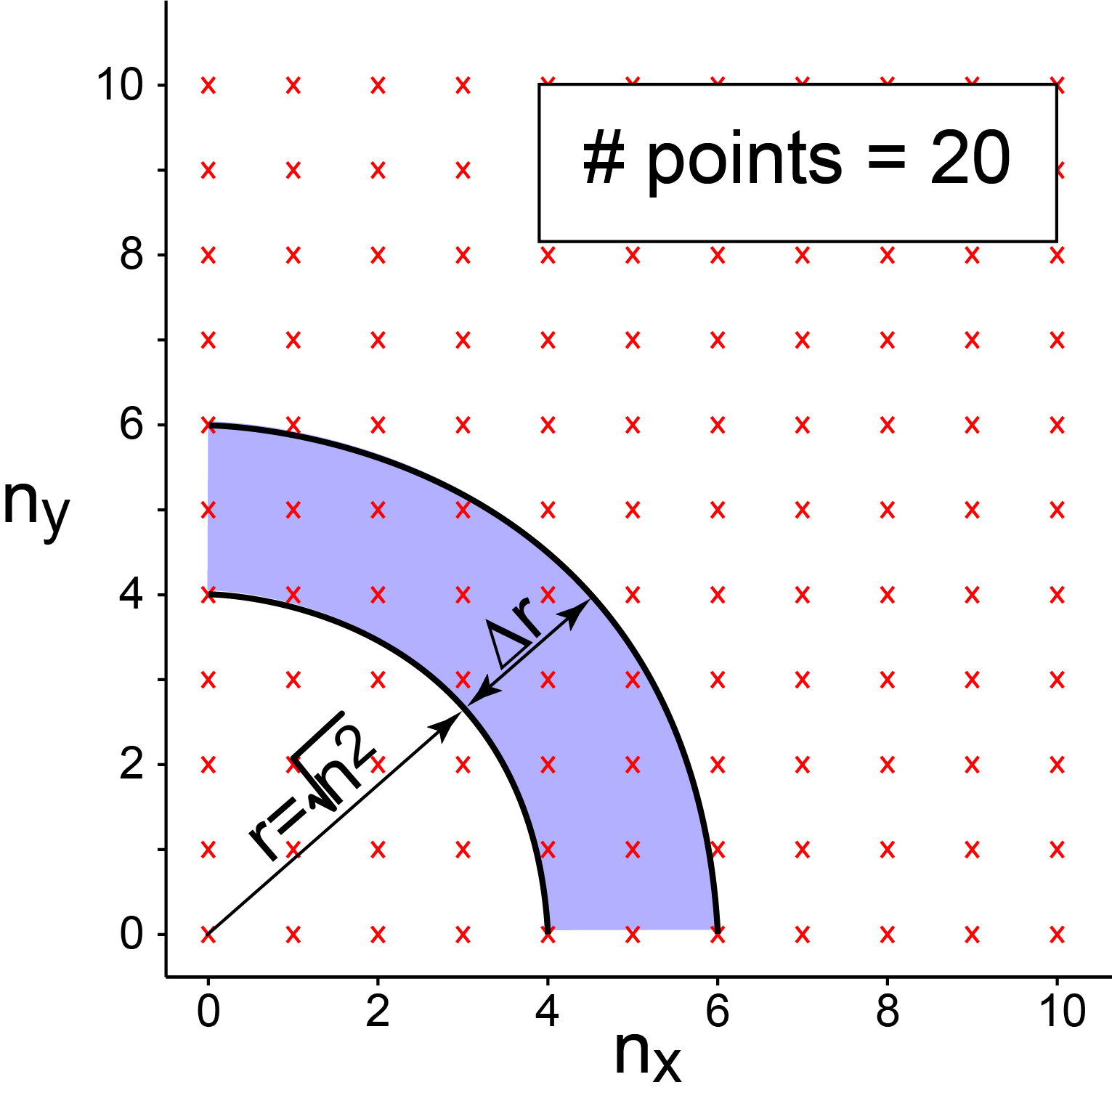
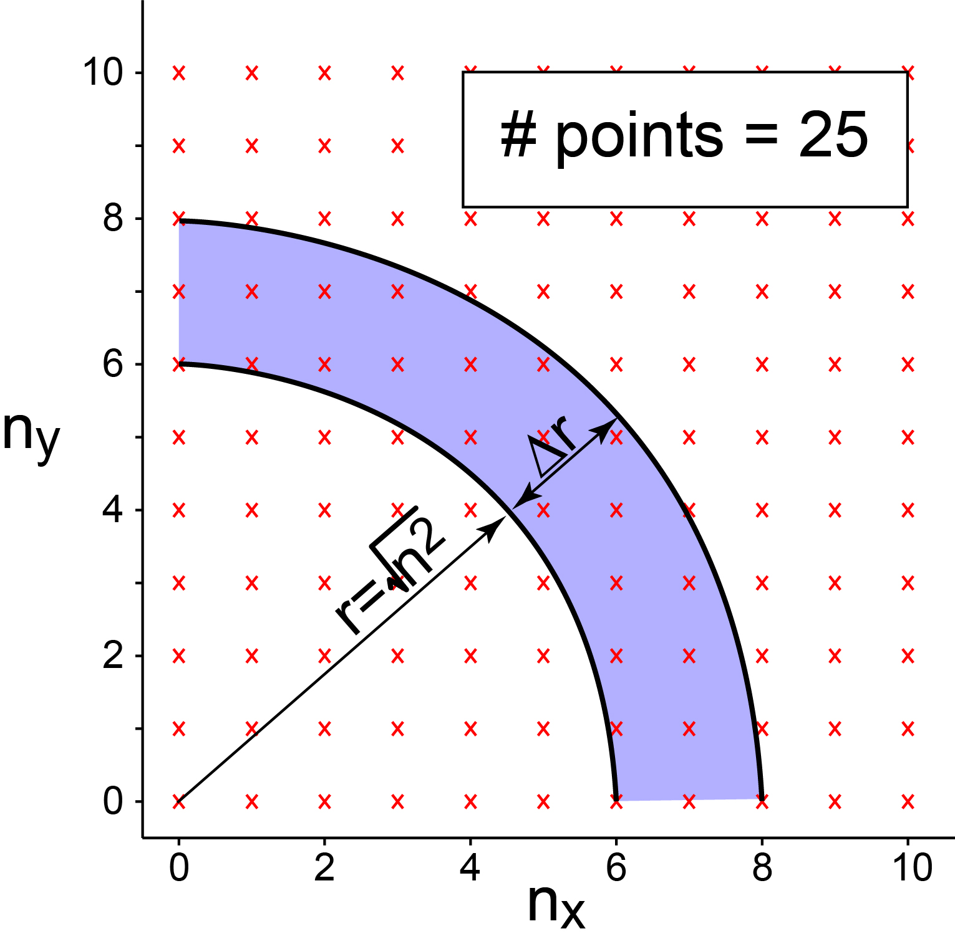
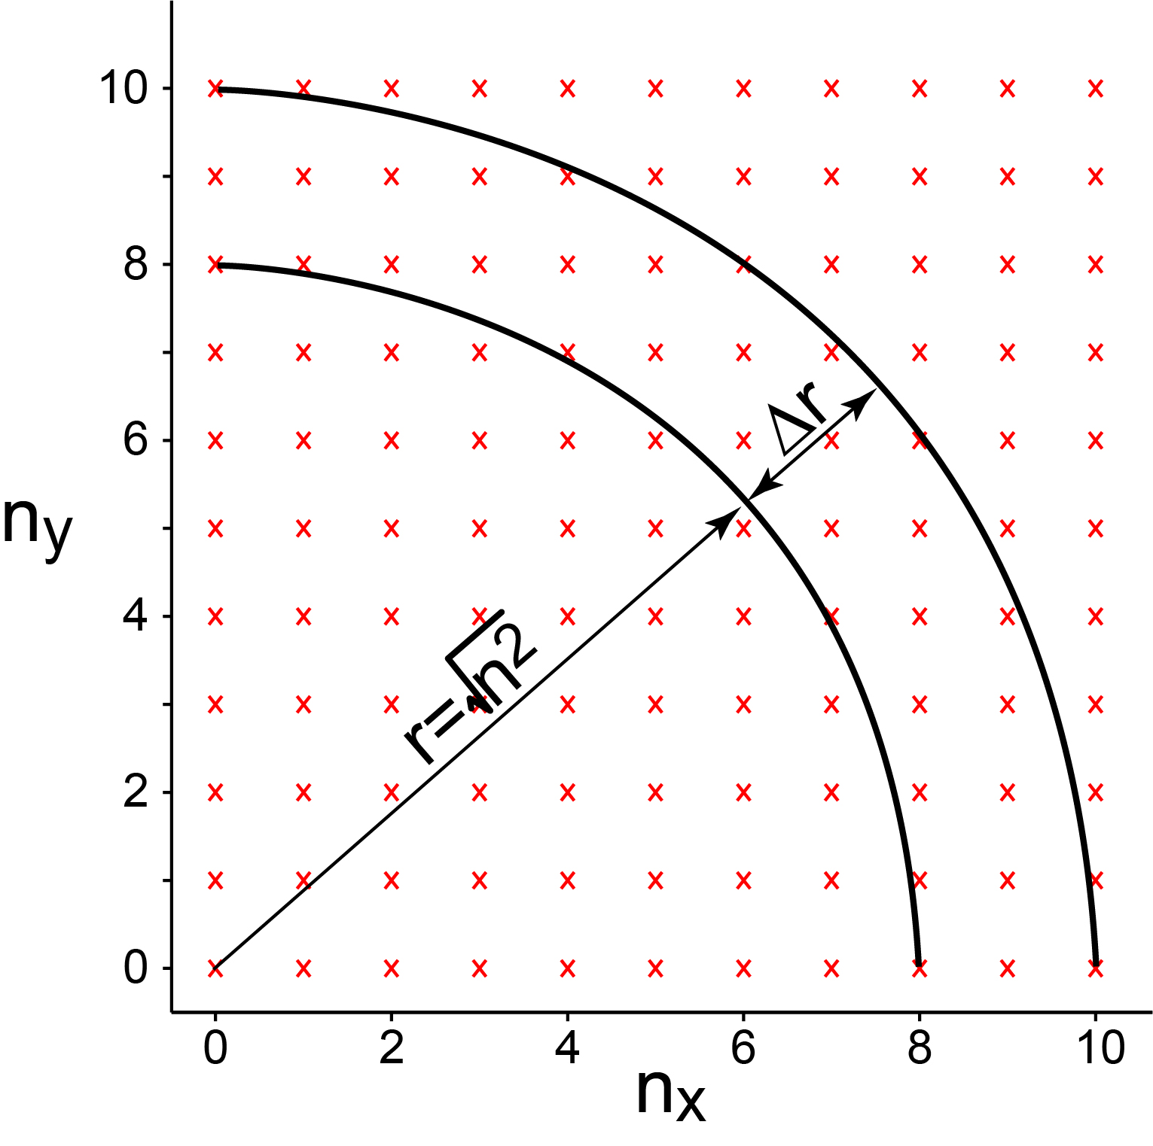
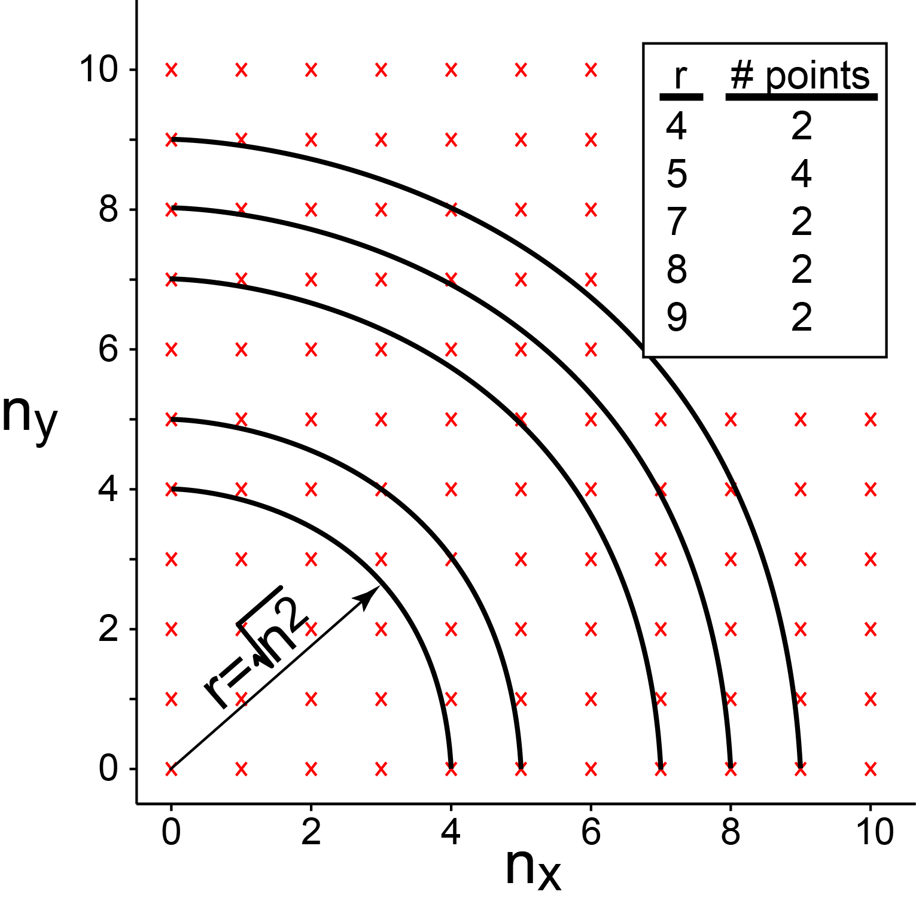
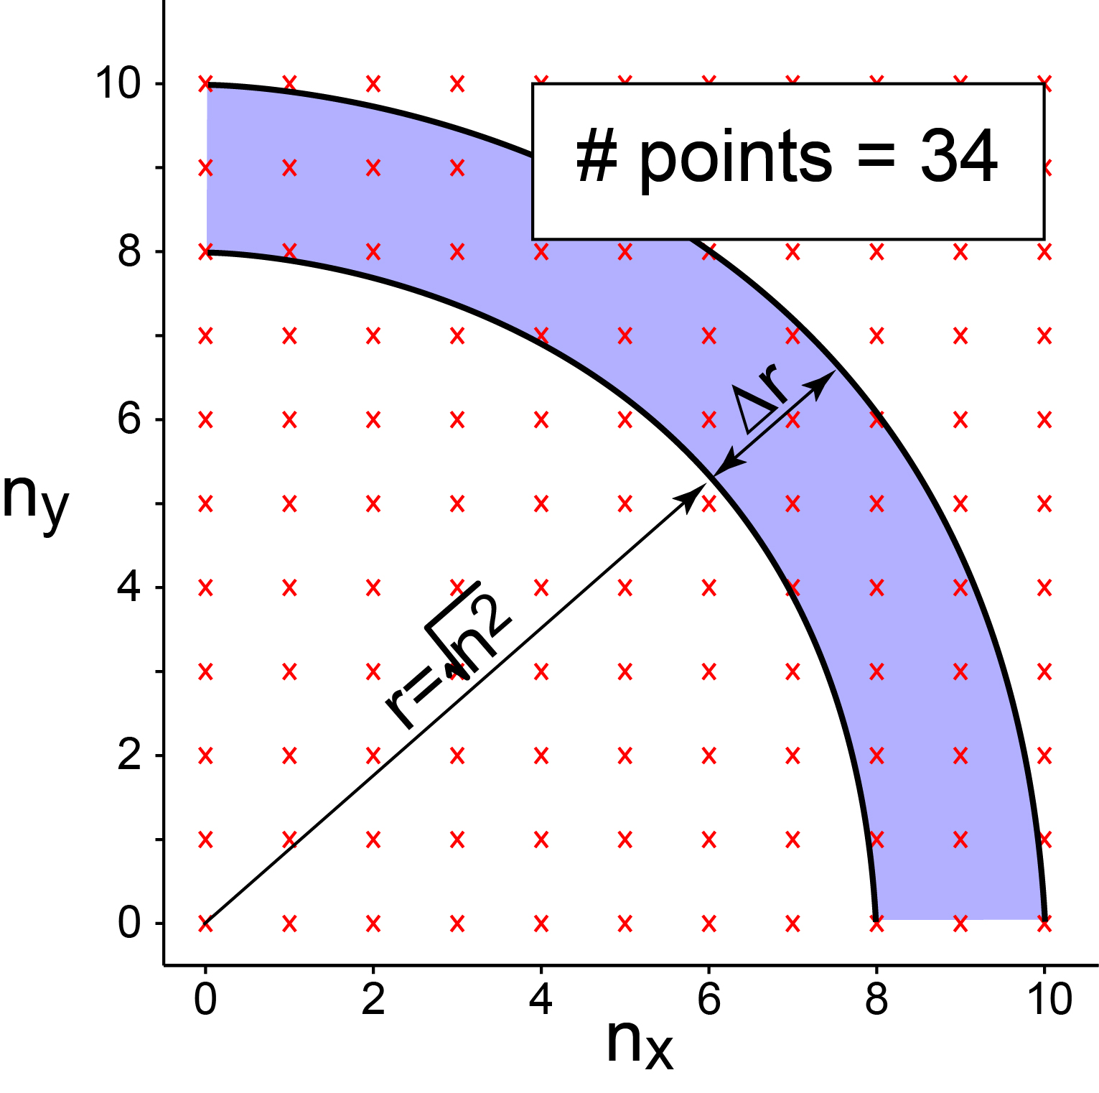
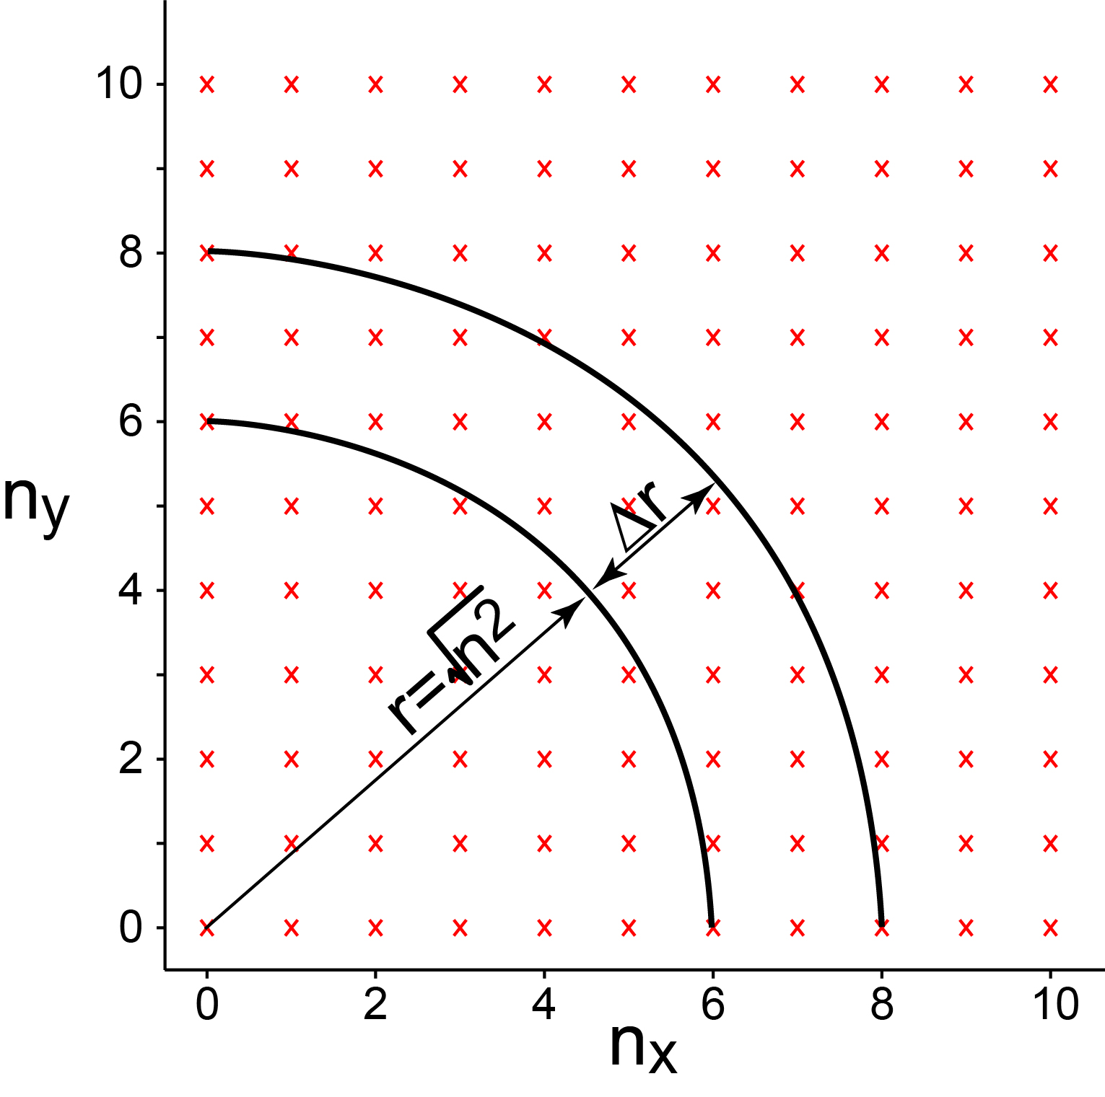
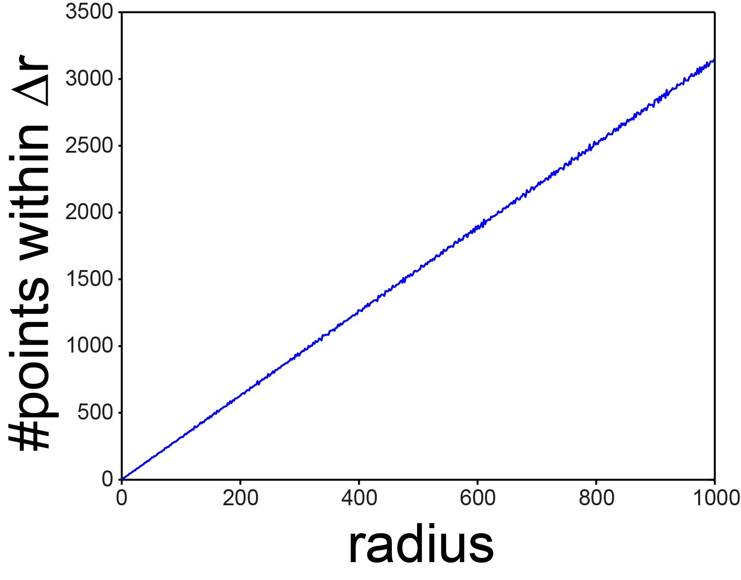
Counting Modes: 2D
$λ^{2}=\frac{4L^{2}}{n^{2}}$ where $n^{2}={ n}_{x}^{2}+n_{y}^{2}$. Therefore we know what are the allowed wavelengths. But how many?
Example: if $λ=L$ then $n^{2}=$4. There are two modes
that have $n^{2}=$4 (n_{x}=2, n_{y}=0 and n_{x}=0, n_{y}=2 ).
How do we know the number of modes for every $λ$?
i.e. we need to count every “x” in this figure. Can we do
so as a function of n²?
Create an area and count the number of modes within that area!
$radius=$ $\sqrt{n^{2}}$= $\sqrt{{n_{x}^{2}+n}_{y}^{2}}$
There doesn’t seem to be a function for the number of points (n_{x}, n_{y}) that have $\sqrt{n^{2}}$ as a radius.

Slide 2
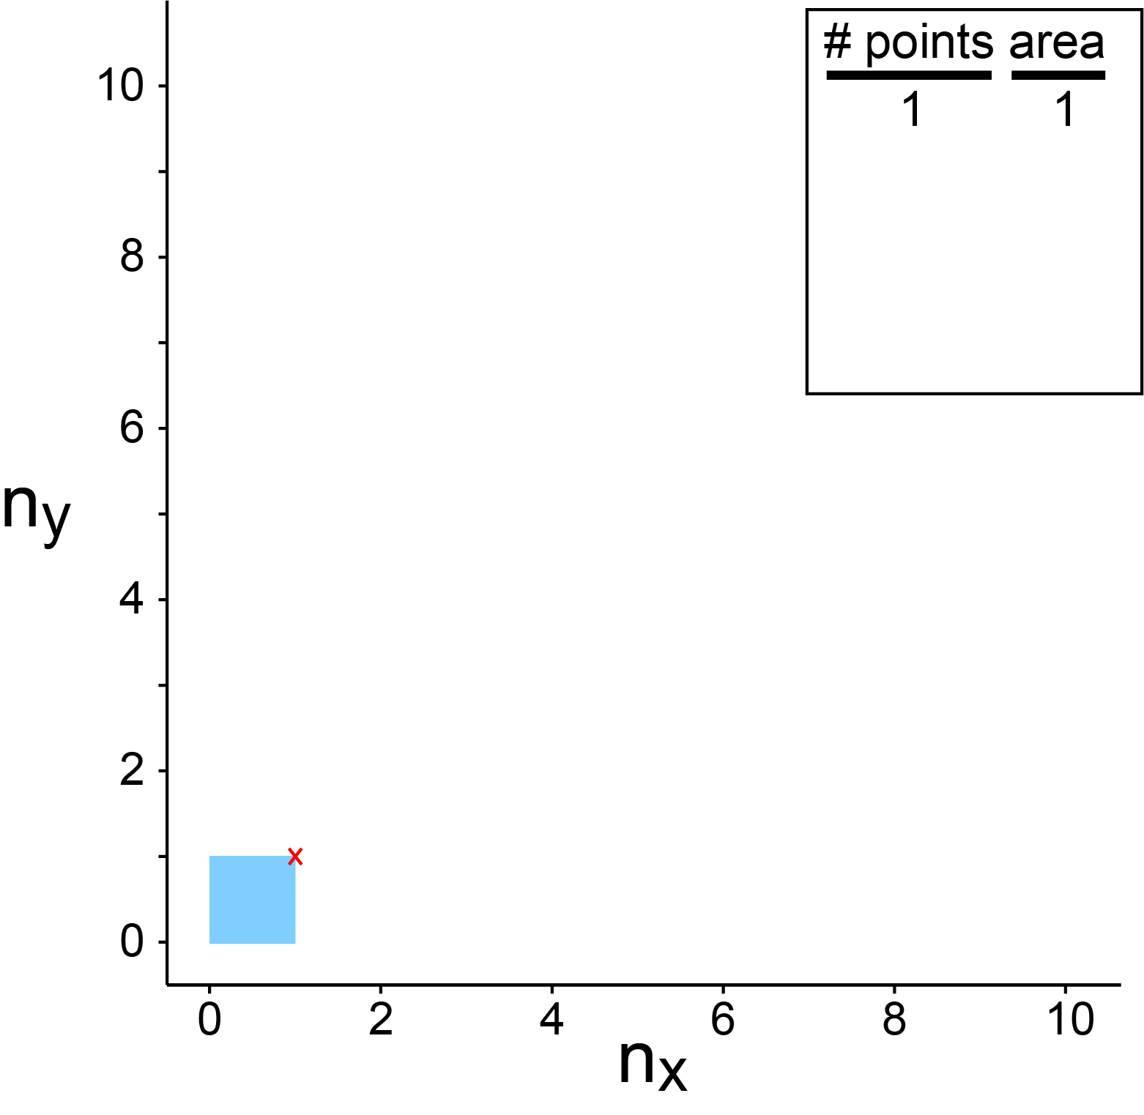
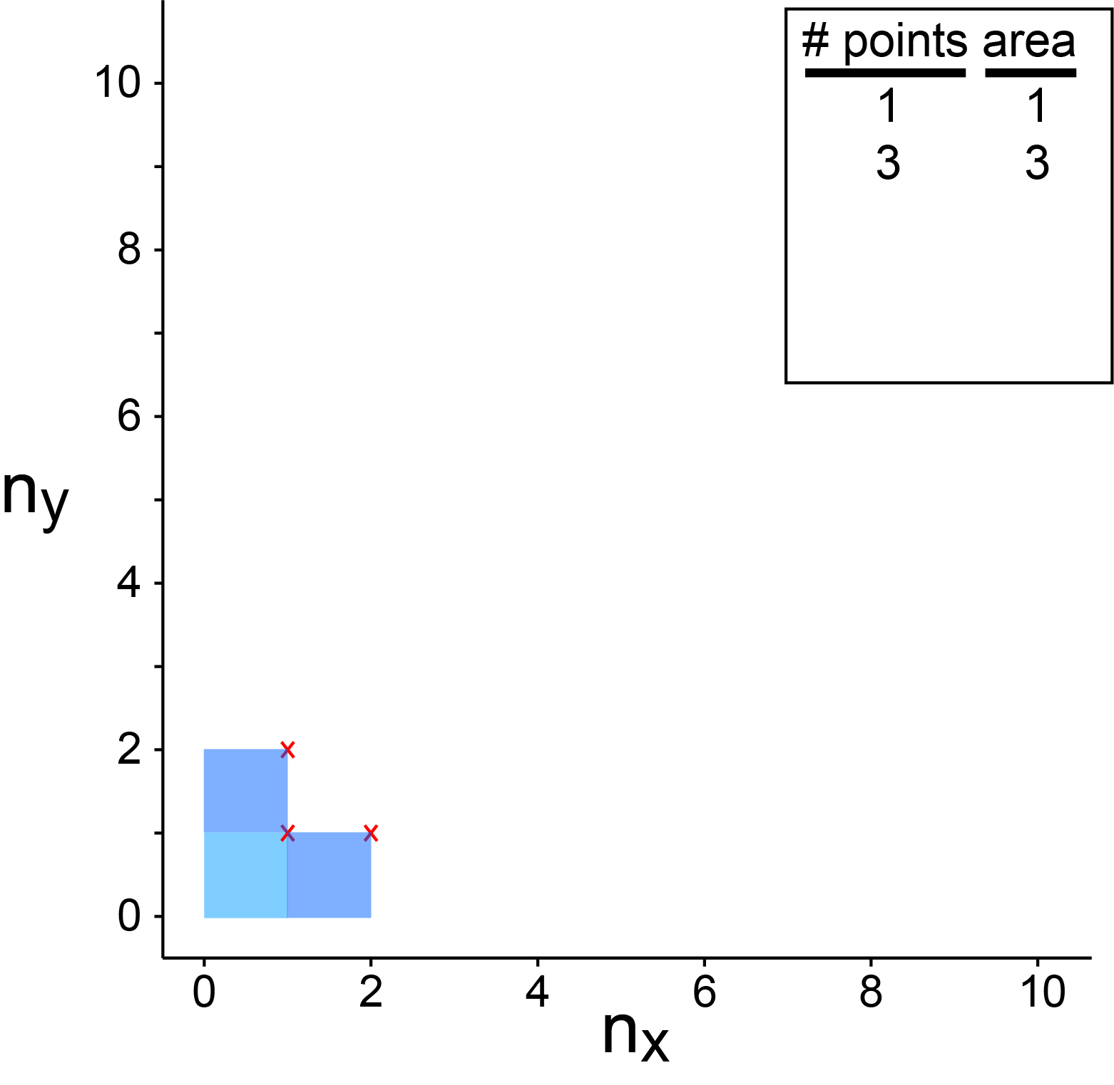
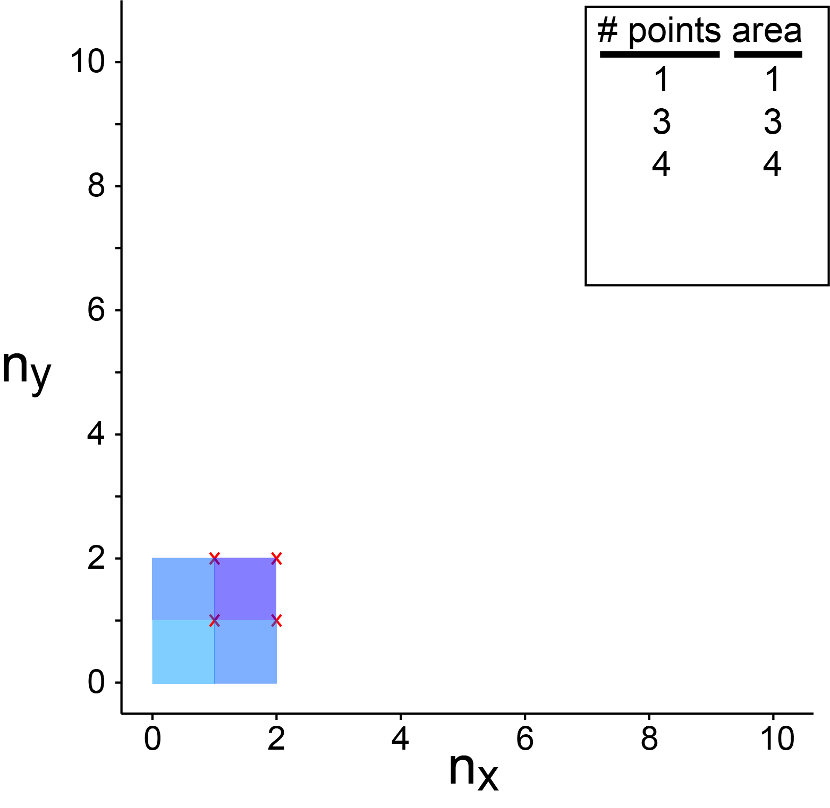
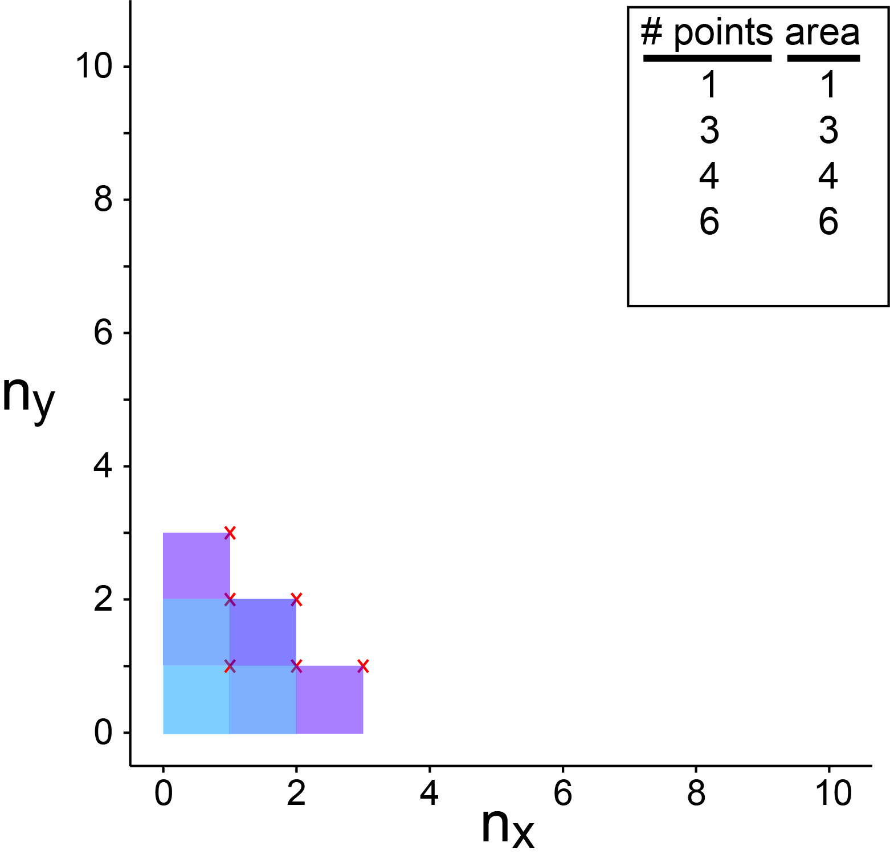
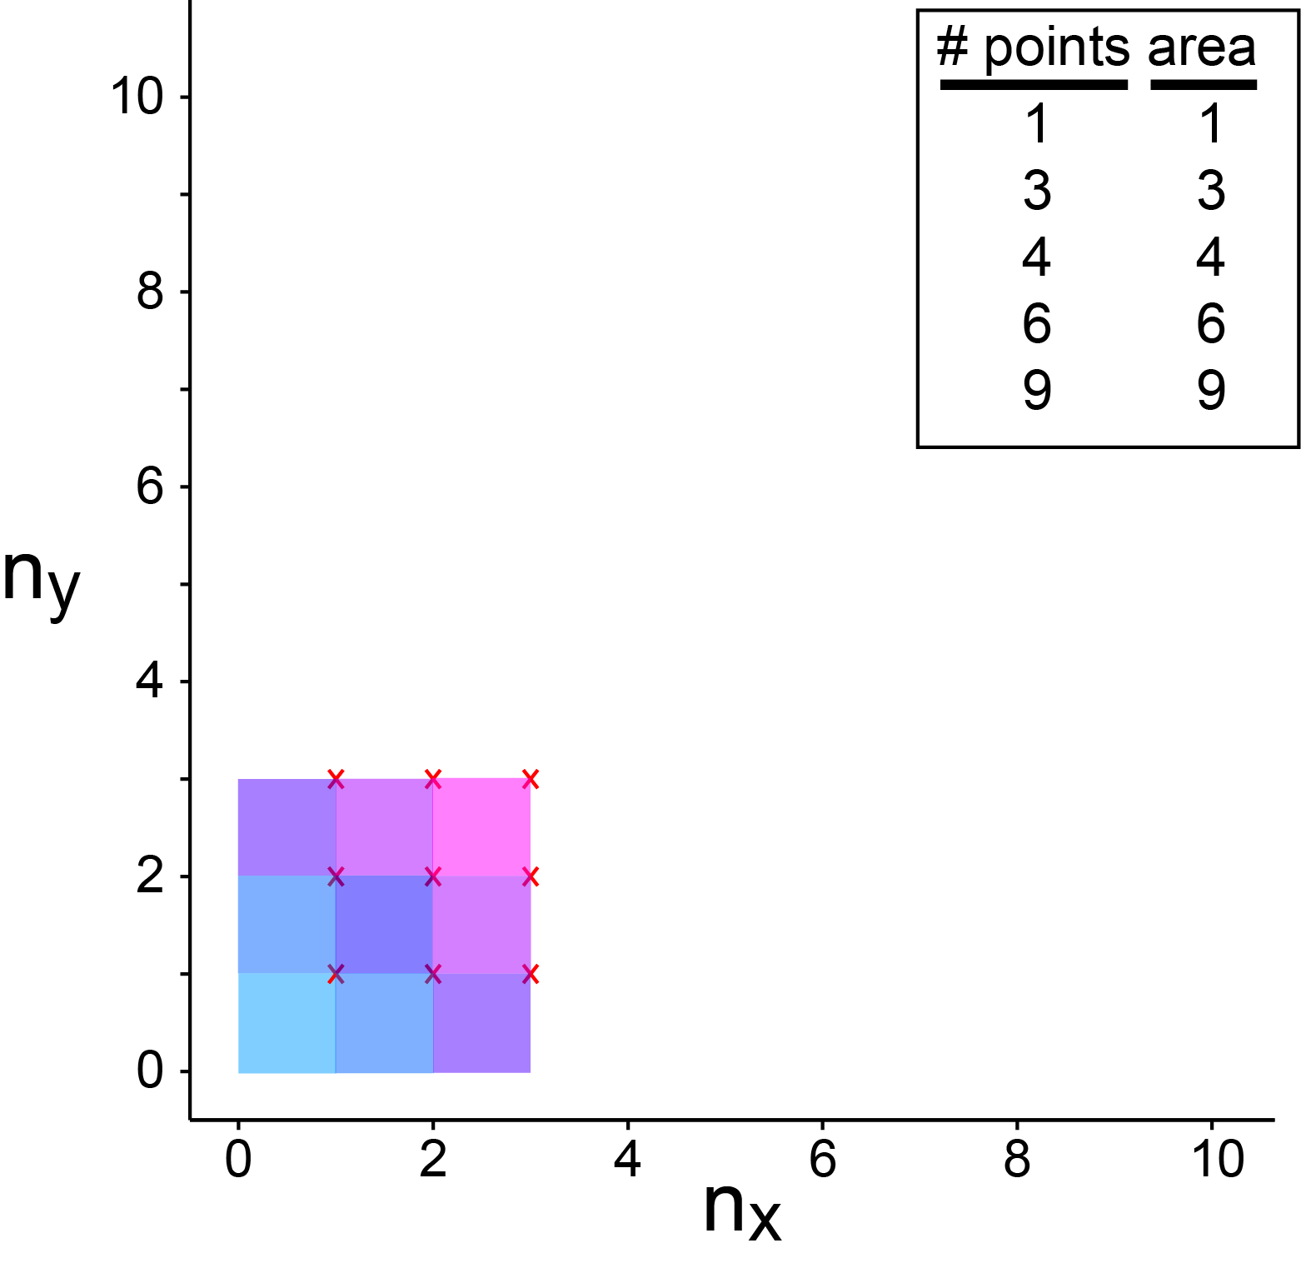
Therefore, what do you guess is the area of this 1/4 disk?

Slide 3
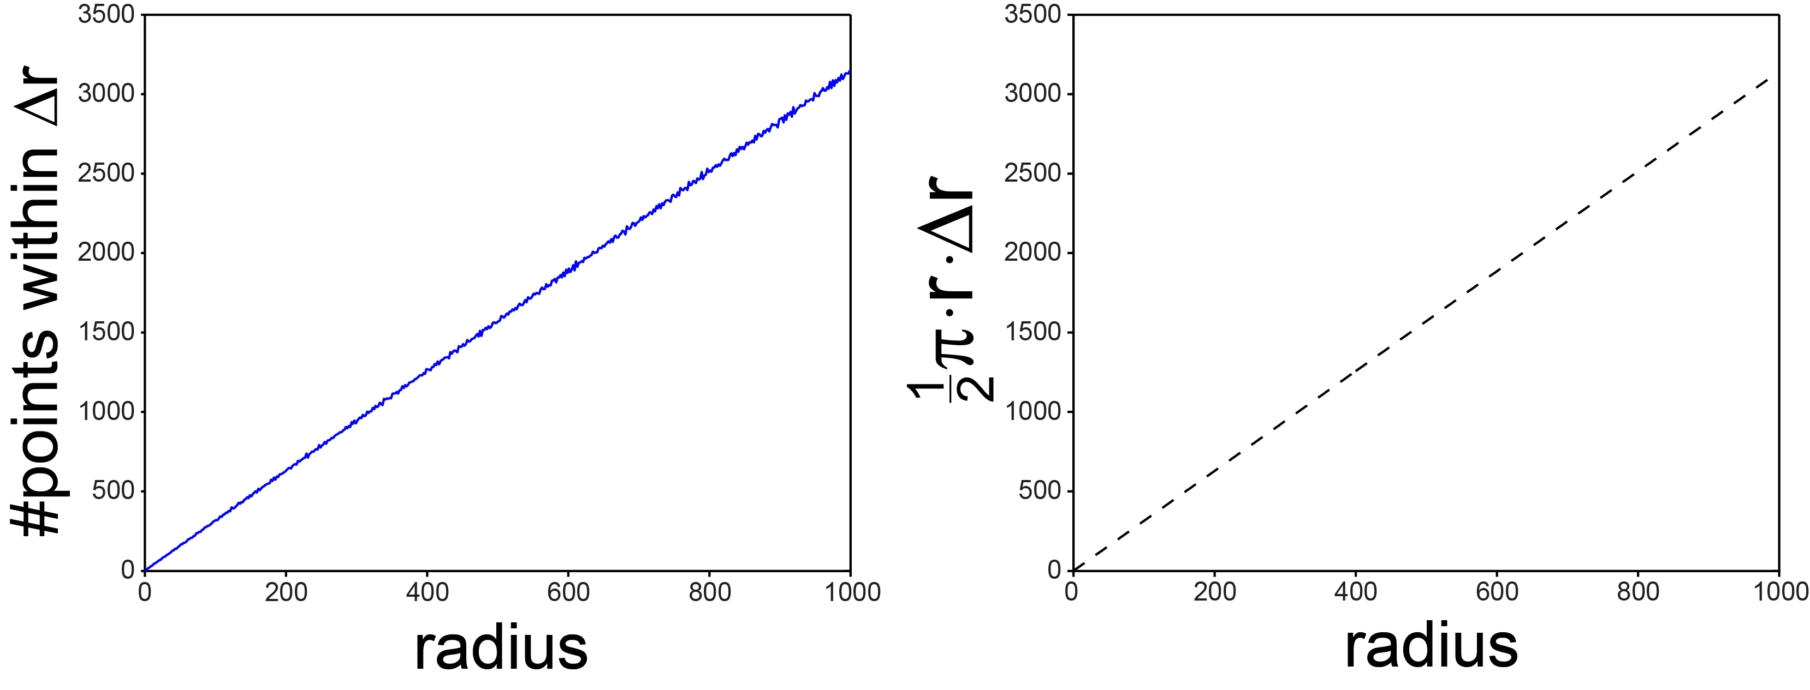
Counting Modes: 2D
Determine the area of the disk: length × width.
Circumference of a $\frac{1}{4}$ circle: $\left(\frac{1}{4}\right)2πr=\frac{1}{2}πr.$
Area of a disk $\sim \frac{1}{2}πr×∆r$ = number of modes.

Slide 4
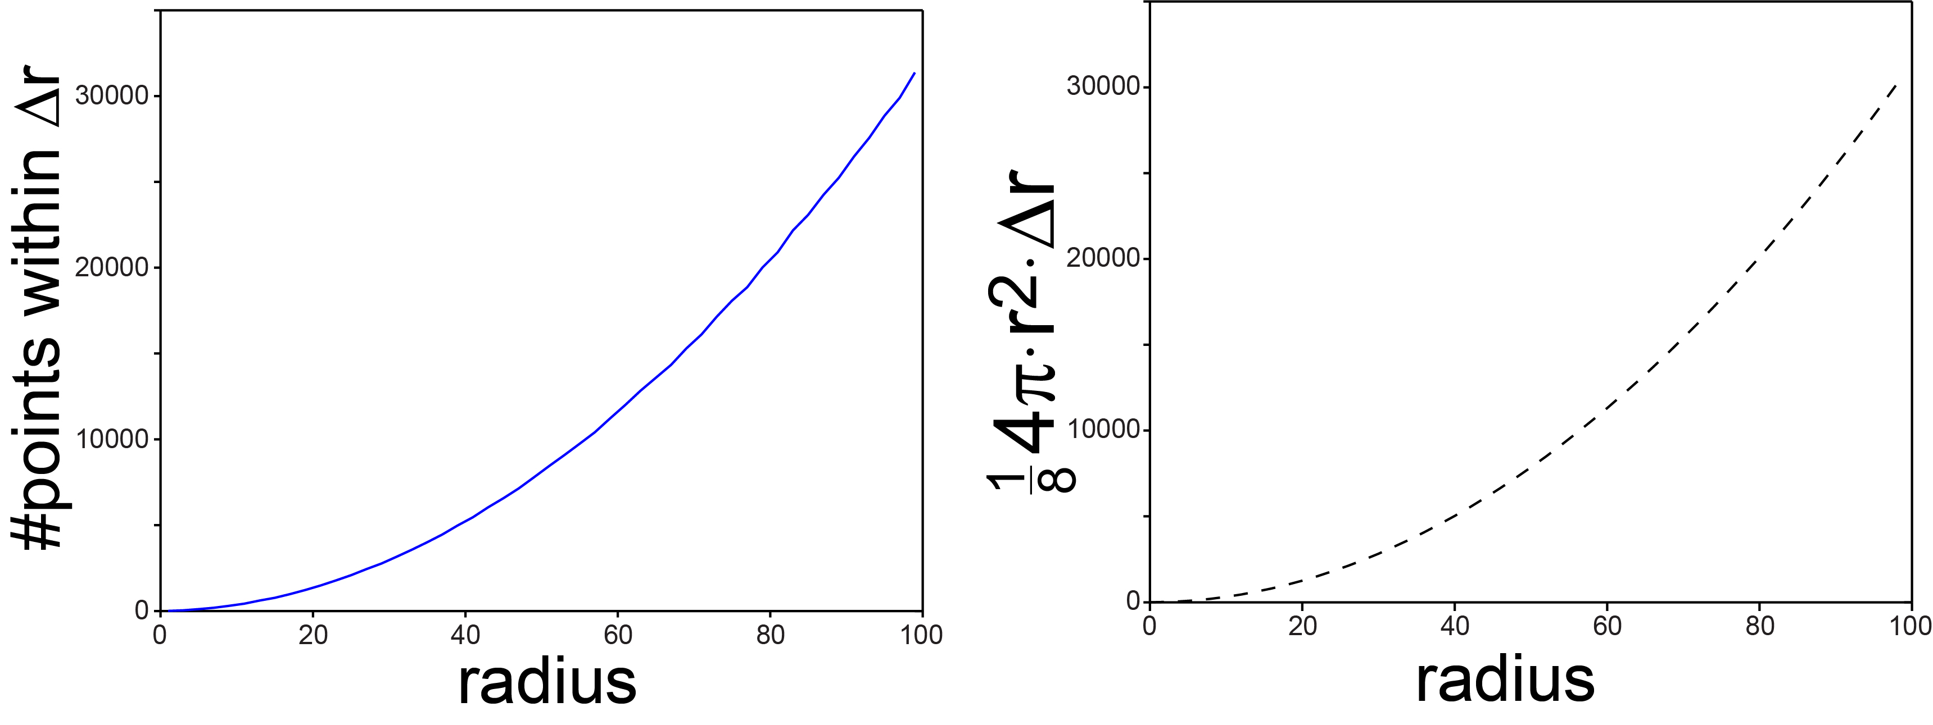
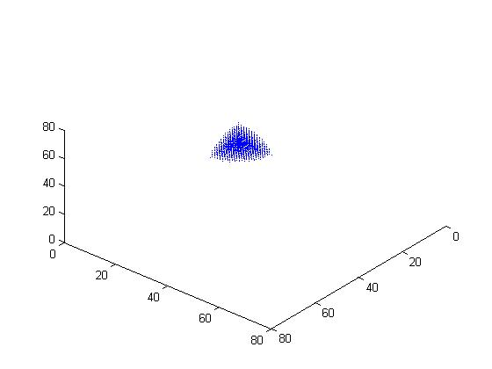
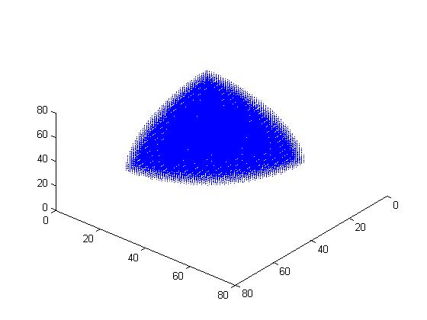
Counting Modes: 3D
Determine the volume of a shell: area × thickness.
Area of a $\frac{1}{8}$ sphere: $\left(\frac{1}{8}\right)4πr^{2}=2πr^{2}.$
Volume of a shell $\sim \left(\frac{1}{8}\right)4πr^{2}×∆r$ = number of modes in 3D.
n=14
n=44

