Slide 1
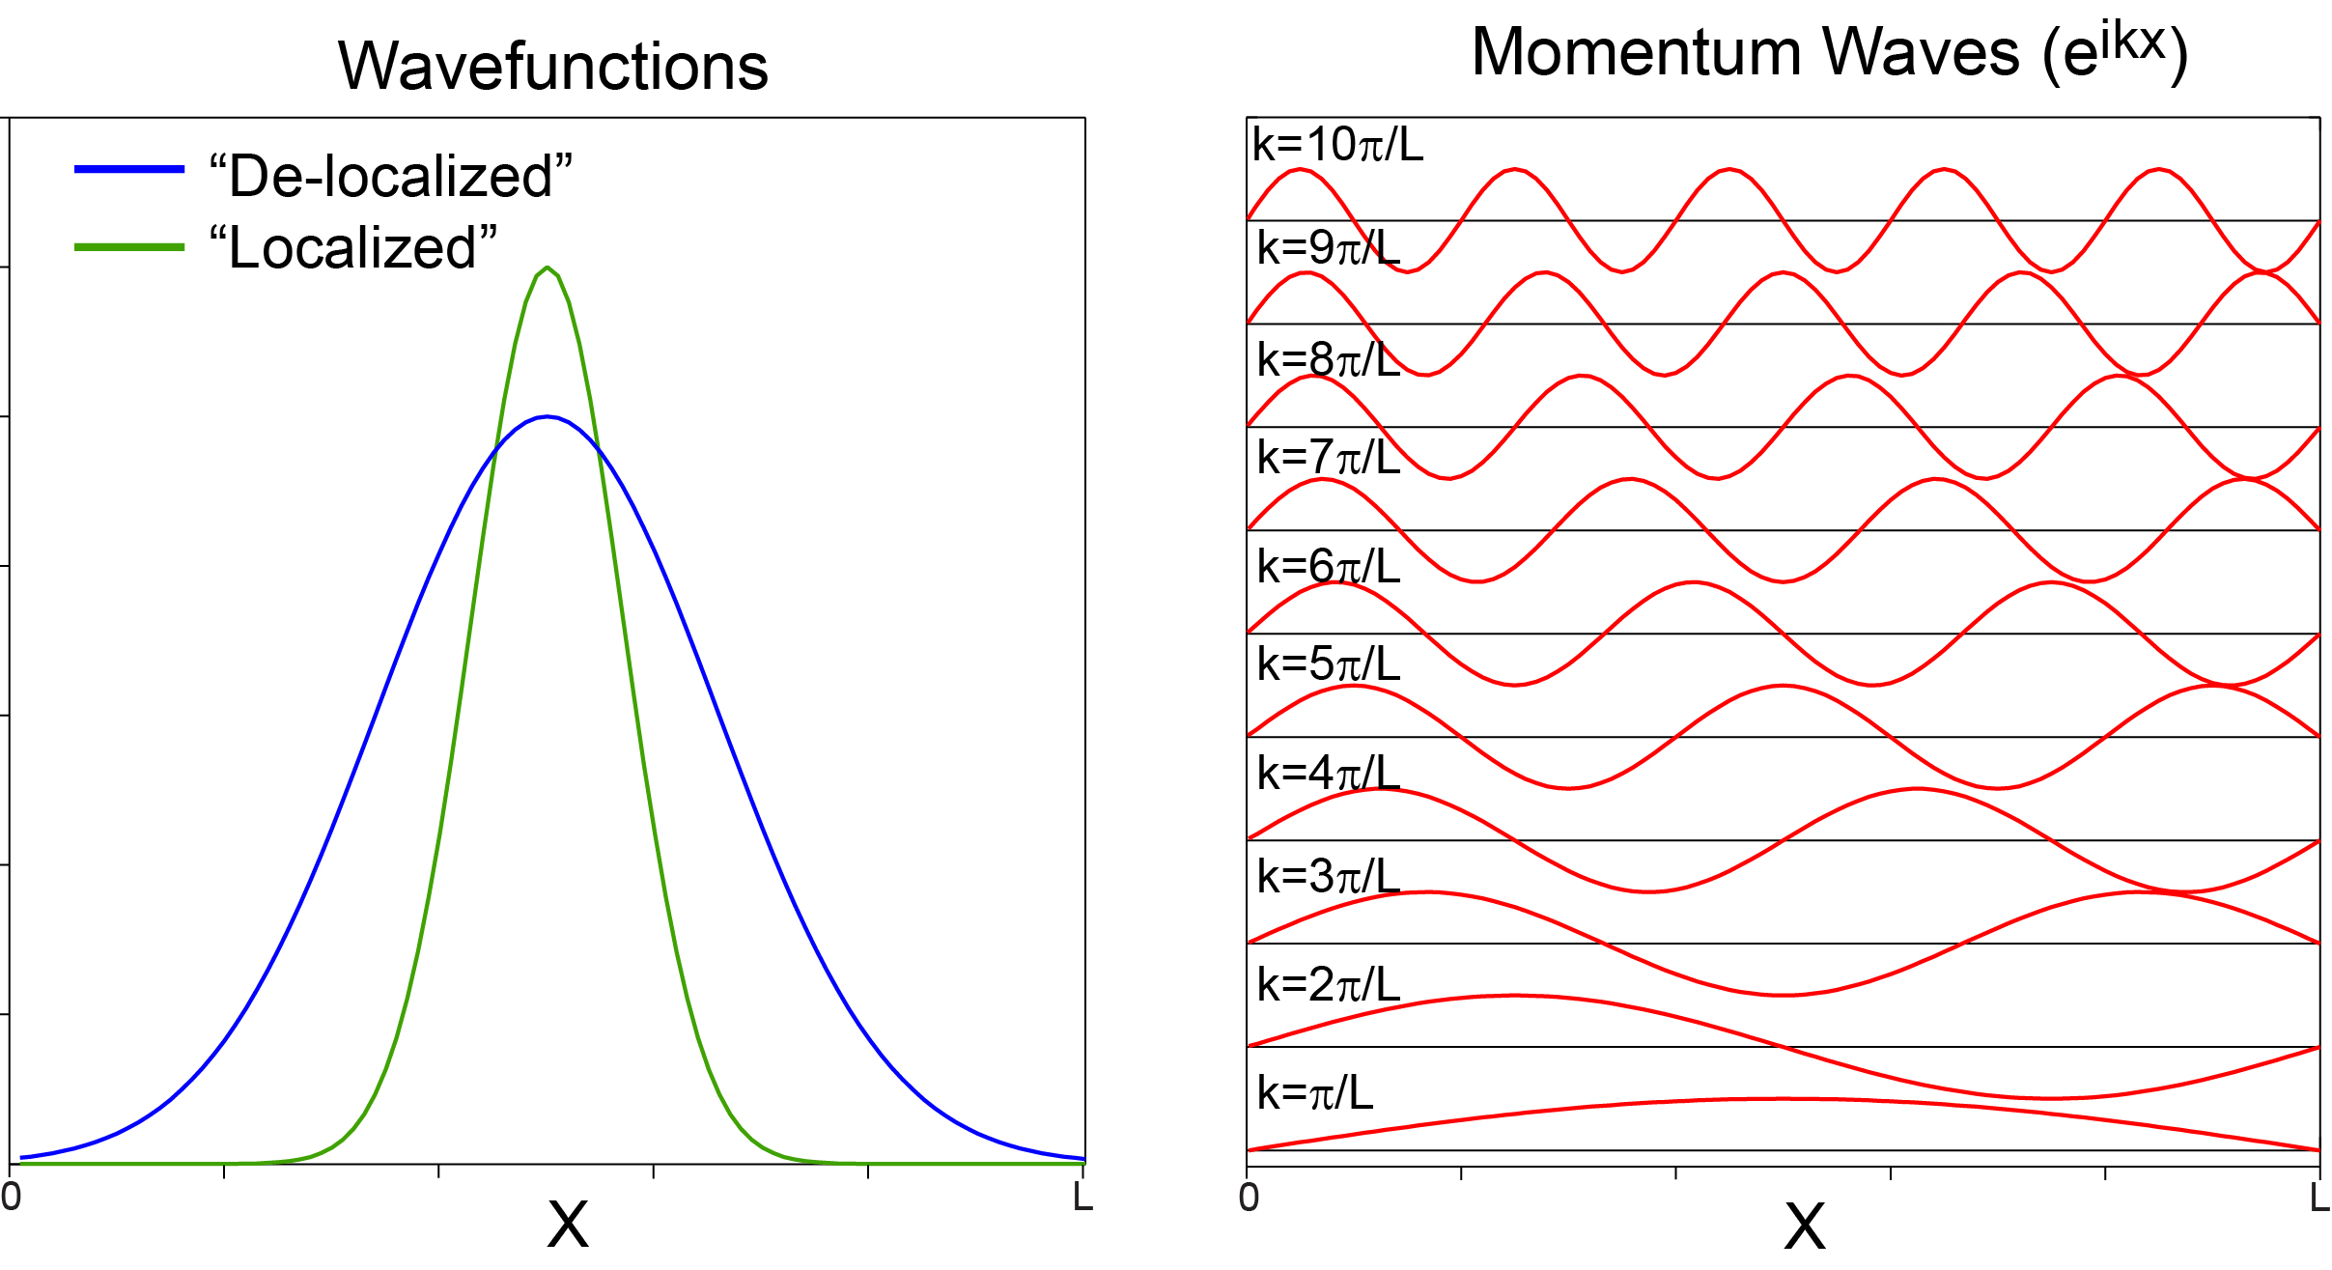
Decomposing wavefunctions into waves

Slide 2
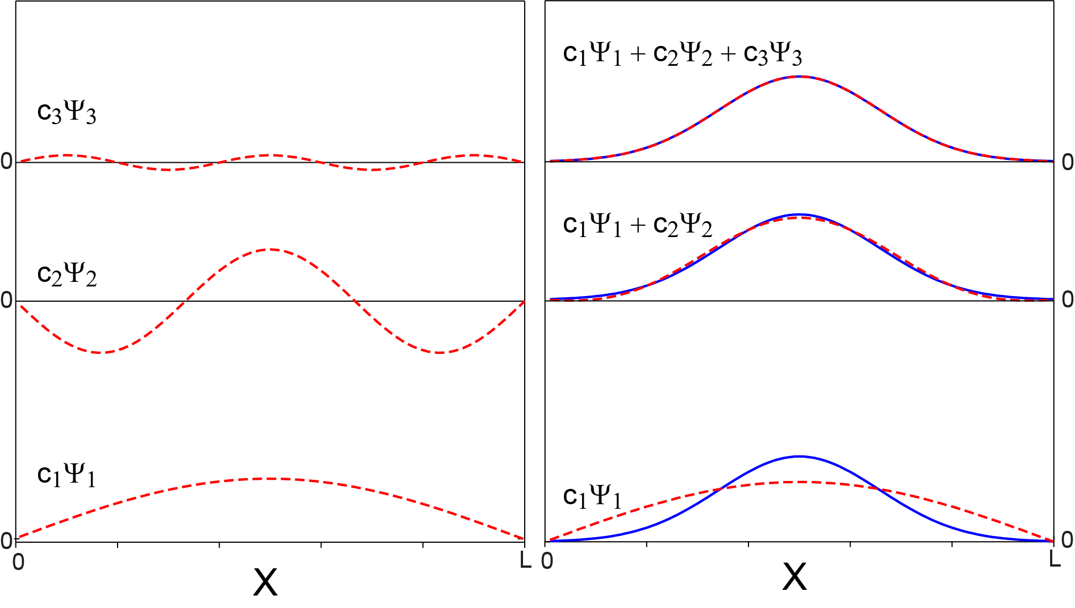
Delocalized is an easy fit!

Slide 3
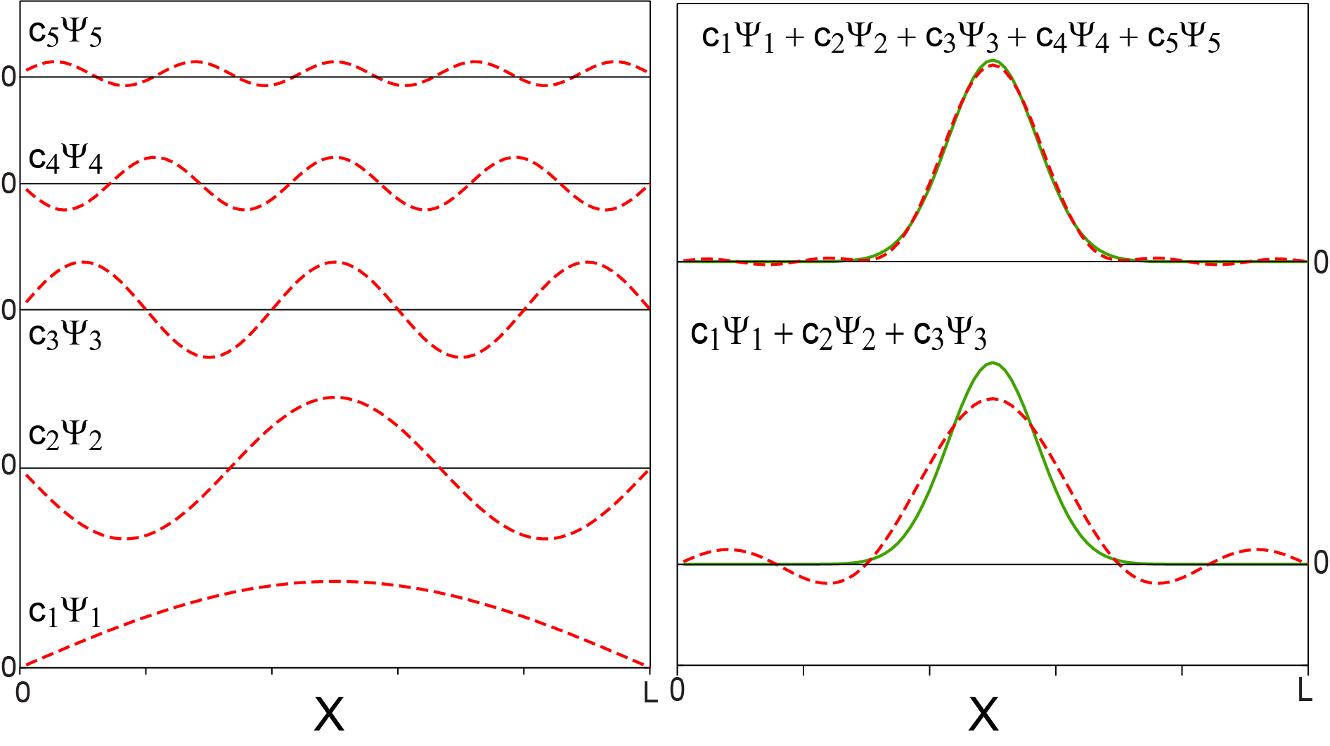
Localized … not so much

