Slide 1
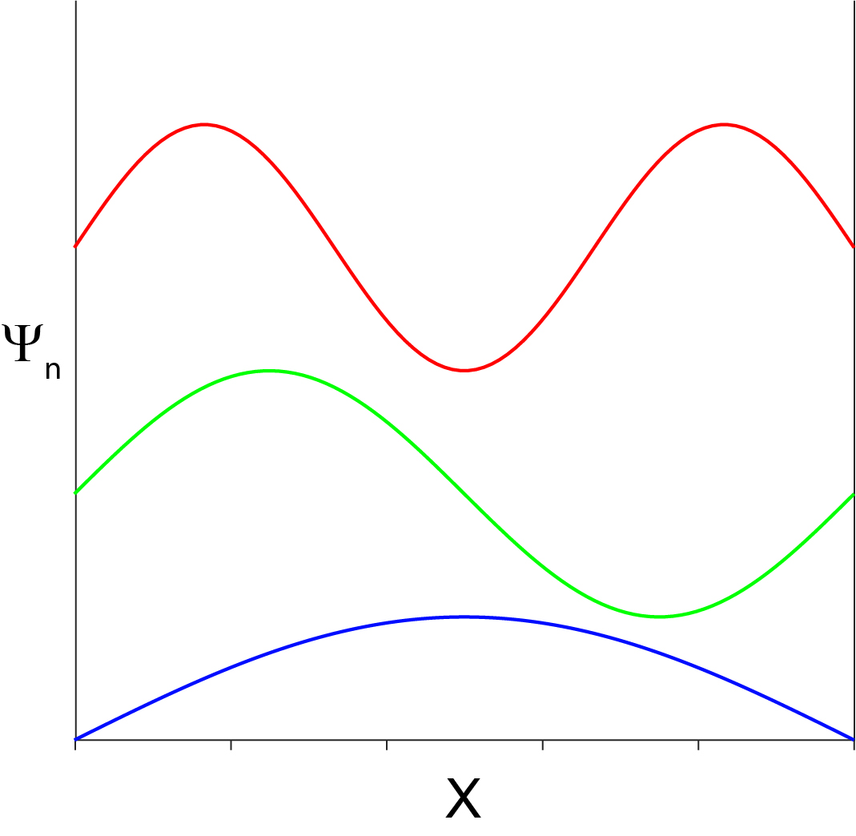
Diagonalization of a Hamiltonian
Hamiltonian Matrix:
Basis set: particle in a box:
$$\left[\begin{matrix}\int{ψ_{1}^{∗}Hψ_{1}∂τ} & \int{ψ_{2}^{∗}Hψ_{1}∂τ} & \int{ψ_{3}^{∗}Hψ_{1}∂τ} \\ \int{ψ_{1}^{∗}Hψ_{2}∂τ} & \int{ψ_{2}^{∗}Hψ_{2}∂τ} & \int{ψ_{3}^{∗}Hψ_{2}∂τ} \\ \int{ψ_{1}^{∗}Hψ_{3}∂τ} & \int{ψ_{2}^{∗}Hψ_{3}∂τ} & \int{ψ_{3}^{∗}Hψ_{3}∂τ}\end{matrix}\right]$$
$\frac{−ℏ^{2}}{2m}\frac{∂^{2}}{∂x^{2}}$+ $\sqrt{\frac{k_{f}}{m}}x^{2}$
Hamiltonian:

Slide 2
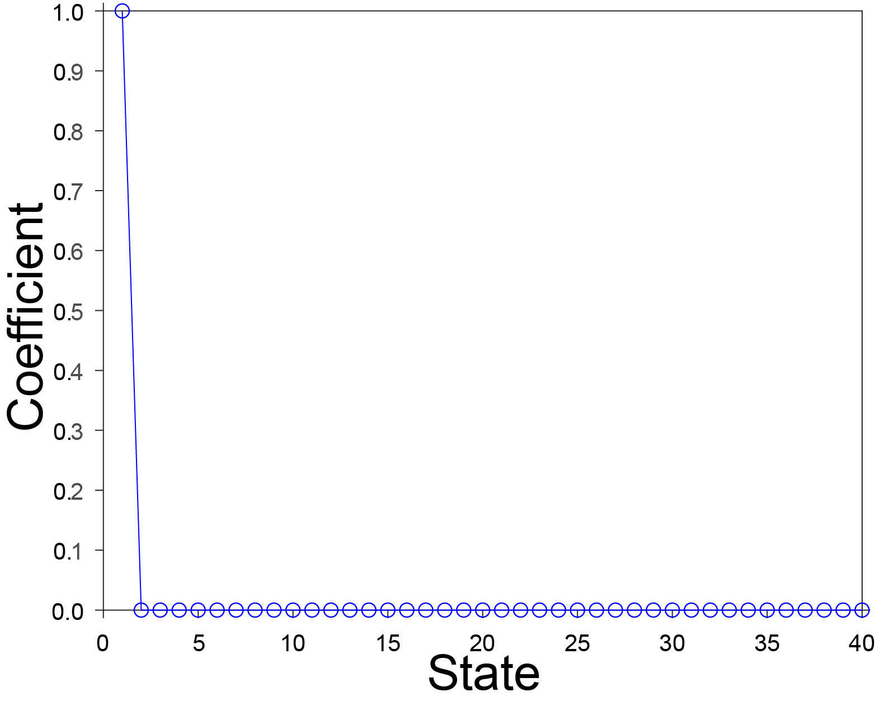
k_{f}=0
$$\left[\begin{matrix}\int_{0}^{L}{\left(\frac{2}{L}\right)sin\left(\frac{πx}{L}\right)∙\frac{−ℏ^{2}}{2m}}\frac{∂^{2}}{∂x^{2}}sin\left(\frac{πx}{L}\right)∂x+\int_{0}^{L}{\left(\frac{2}{L}\right)sin\left(\frac{πx}{L}\right)∙\sqrt{\frac{k_{f}}{m}}}x^{2}sin\left(\frac{πx}{L}\right)∂x & \int_{0}^{L}{\left(\frac{2}{L}\right)sin\left(\frac{2πx}{L}\right)∙\frac{−ℏ^{2}}{2m}}\frac{∂^{2}}{∂x^{2}}sin\left(\frac{πx}{L}\right)∂x+\int_{0}^{L}{\left(\frac{2}{L}\right)sin\left(\frac{2πx}{L}\right)∙\sqrt{\frac{k_{f}}{m}}}x^{2}sin\left(\frac{πx}{L}\right)∂x \\ \int_{0}^{L}{\left(\frac{2}{L}\right)sin\left(\frac{πx}{L}\right)∙\frac{−ℏ^{2}}{2m}}\frac{∂^{2}}{∂x^{2}}sin\left(\frac{2πx}{L}\right)∂x+\int_{0}^{L}{\left(\frac{2}{L}\right)sin\left(\frac{πx}{L}\right)∙\sqrt{\frac{k_{f}}{m}}}x^{2}sin\left(\frac{2πx}{L}\right)∂x & \int_{0}^{L}{\left(\frac{2}{L}\right)sin\left(\frac{2πx}{L}\right)∙\frac{−ℏ^{2}}{2m}}\frac{∂^{2}}{∂x^{2}}sin\left(\frac{2πx}{L}\right)∂x+\int_{0}^{L}{\left(\frac{2}{L}\right)sin\left(\frac{2πx}{L}\right)∙\sqrt{\frac{k_{f}}{m}}x^{2}}sin\left(\frac{2πx}{L}\right)∂x\end{matrix}\right]=$$
0.0493 | 0 | 0 | 0 | 0 | 0 | 0 | 0 | 0 | 0
0 | 0.1974 | 0 | 0 | 0 | 0 | 0 | 0 | 0 | 0
0 | 0 | 0.4441 | 0 | 0 | 0 | 0 | 0 | 0 | 0
0 | 0 | 0 | 0.7895 | 0 | 0 | 0 | 0 | 0 | 0
0 | 0 | 0 | 0 | 1.2336 | 0 | 0 | 0 | 0 | 0
0 | 0 | 0 | 0 | 0 | 1.7764 | 0 | 0 | 0 | 0
0 | 0 | 0 | 0 | 0 | 0 | 2.4178 | 0 | 0 | 0
0 | 0 | 0 | 0 | 0 | 0 | 0 | 3.158 | 0 | 0
0 | 0 | 0 | 0 | 0 | 0 | 0 | 0 | 3.9968 | 0
0 | 0 | 0 | 0 | 0 | 0 | 0 | 0 | 0 | 4.9343

Slide 3
k_{f}>0
$$\left[\begin{matrix}\int_{0}^{L}{\left(\frac{2}{L}\right)sin\left(\frac{πx}{L}\right)∙\frac{−ℏ^{2}}{2m}}\frac{∂^{2}}{∂x^{2}}sin\left(\frac{πx}{L}\right)∂x+\int_{0}^{L}{\left(\frac{2}{L}\right)sin\left(\frac{πx}{L}\right)∙\sqrt{\frac{k_{f}}{m}}}x^{2}sin\left(\frac{πx}{L}\right)∂x & \int_{0}^{L}{\left(\frac{2}{L}\right)sin\left(\frac{2πx}{L}\right)∙\frac{−ℏ^{2}}{2m}}\frac{∂^{2}}{∂x^{2}}sin\left(\frac{πx}{L}\right)∂x+\int_{0}^{L}{\left(\frac{2}{L}\right)sin\left(\frac{2πx}{L}\right)∙\sqrt{\frac{k_{f}}{m}}}x^{2}sin\left(\frac{πx}{L}\right)∂x \\ \int_{0}^{L}{\left(\frac{2}{L}\right)sin\left(\frac{πx}{L}\right)∙\frac{−ℏ^{2}}{2m}}\frac{∂^{2}}{∂x^{2}}sin\left(\frac{2πx}{L}\right)∂x+\int_{0}^{L}{\left(\frac{2}{L}\right)sin\left(\frac{πx}{L}\right)∙\sqrt{\frac{k_{f}}{m}}}x^{2}sin\left(\frac{2πx}{L}\right)∂x & \int_{0}^{L}{\left(\frac{2}{L}\right)sin\left(\frac{2πx}{L}\right)∙\frac{−ℏ^{2}}{2m}}\frac{∂^{2}}{∂x^{2}}sin\left(\frac{2πx}{L}\right)∂x+\int_{0}^{L}{\left(\frac{2}{L}\right)sin\left(\frac{2πx}{L}\right)∙\sqrt{\frac{k_{f}}{m}}x^{2}}sin\left(\frac{2πx}{L}\right)∂x\end{matrix}\right]=$$
16.3841 | 0 | 18.9958 | 0 | 3.5177 | 0 | 1.2312 | 0 | 0.5699 | 0
0 | 35.5279 | 0 | 22.5136 | 0 | 4.749 | 0 | 1.8011 | 0 | 0.8794
18.9958 | 0 | 39.2924 | 0 | 23.7448 | 0 | 5.3188 | 0 | 2.1106 | 0
0 | 22.5136 | 0 | 40.869 | 0 | 24.3147 | 0 | 5.6284 | 0 | 2.2973
3.5177 | 0 | 23.7448 | 0 | 41.883 | 0 | 24.6242 | 0 | 5.815 | 0
0 | 4.749 | 0 | 24.3147 | 0 | 42.7353 | 0 | 24.8109 | 0 | 5.9362
1.2312 | 0 | 5.3188 | 0 | 24.6242 | 0 | 43.5634 | 0 | 24.932 | 0
0 | 1.8011 | 0 | 5.6284 | 0 | 24.8109 | 0 | 44.4247 | 0 | 25.0151
0.5699 | 0 | 2.1106 | 0 | 5.815 | 0 | 24.932 | 0 | 45.3466 | 0
0 | 0.8794 | 0 | 2.2973 | 0 | 5.9362 | 0 | 25.0151 | 0 | 46.3435

Slide 4
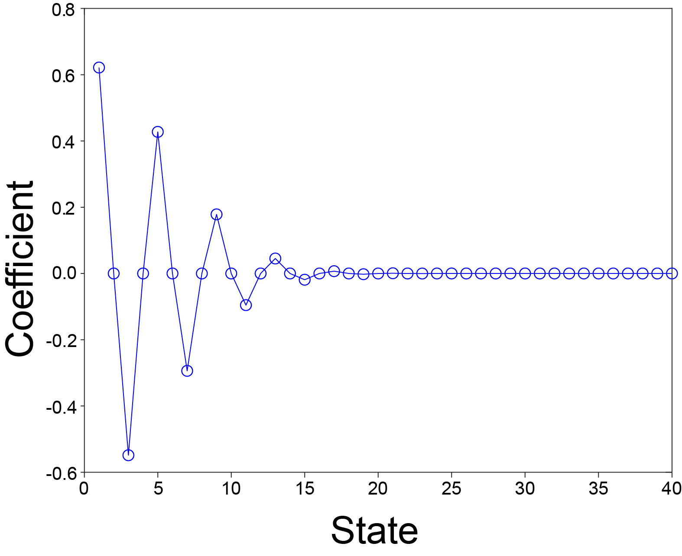
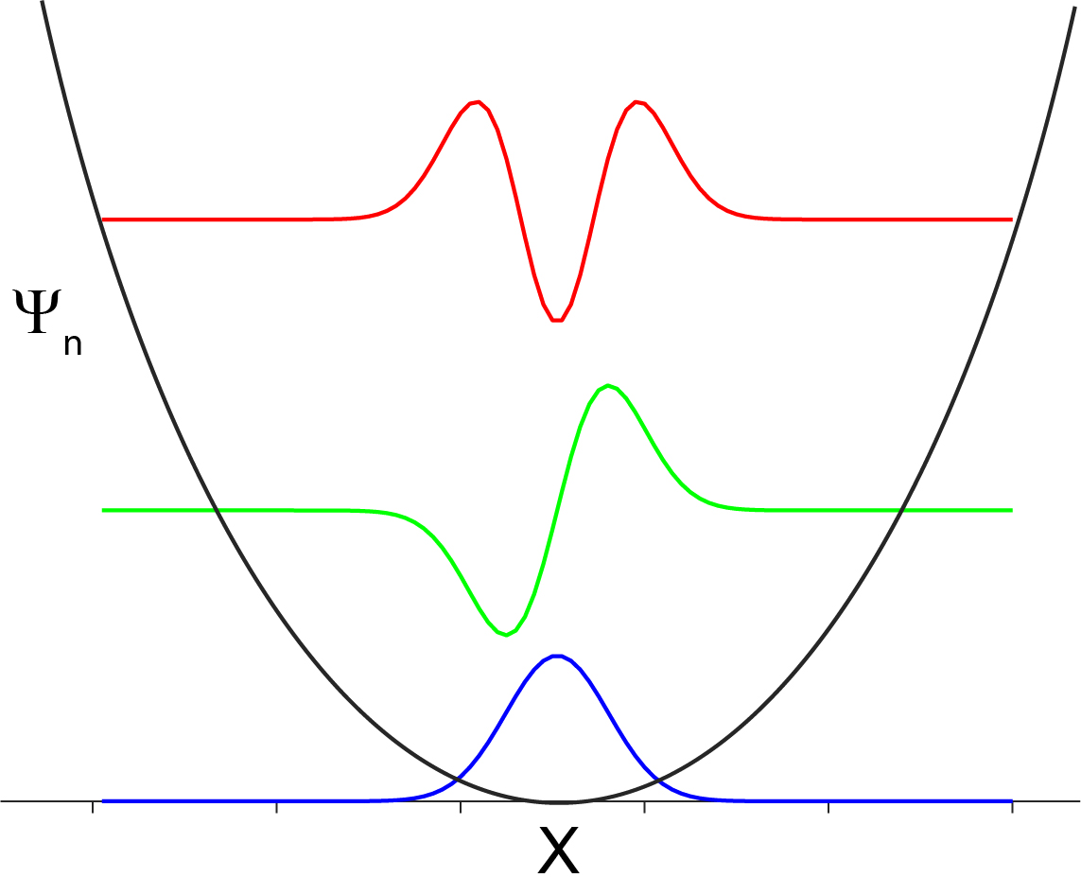
k_{f}>0

