Slide 1
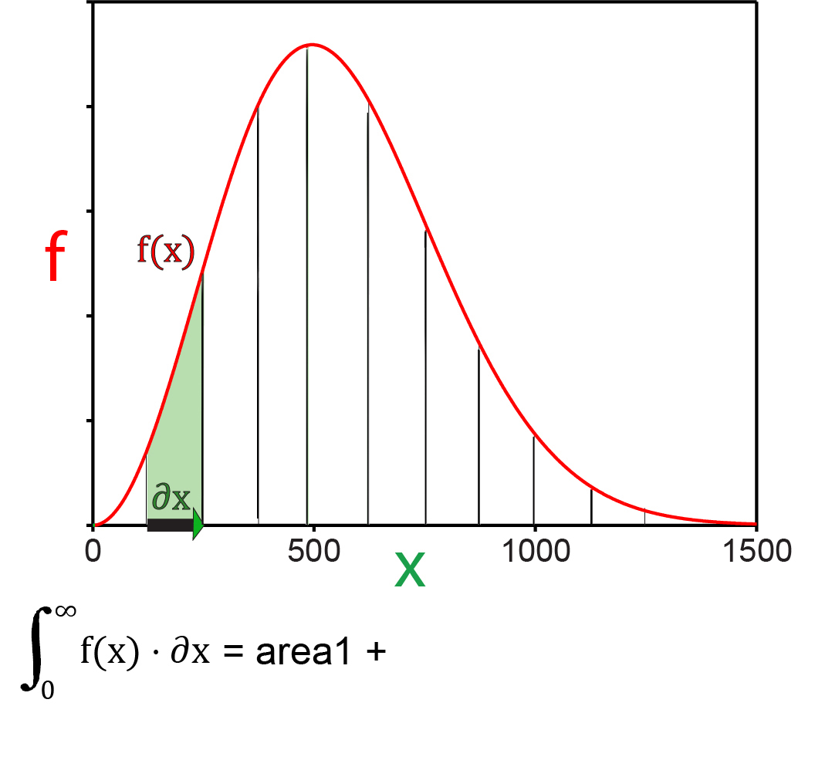
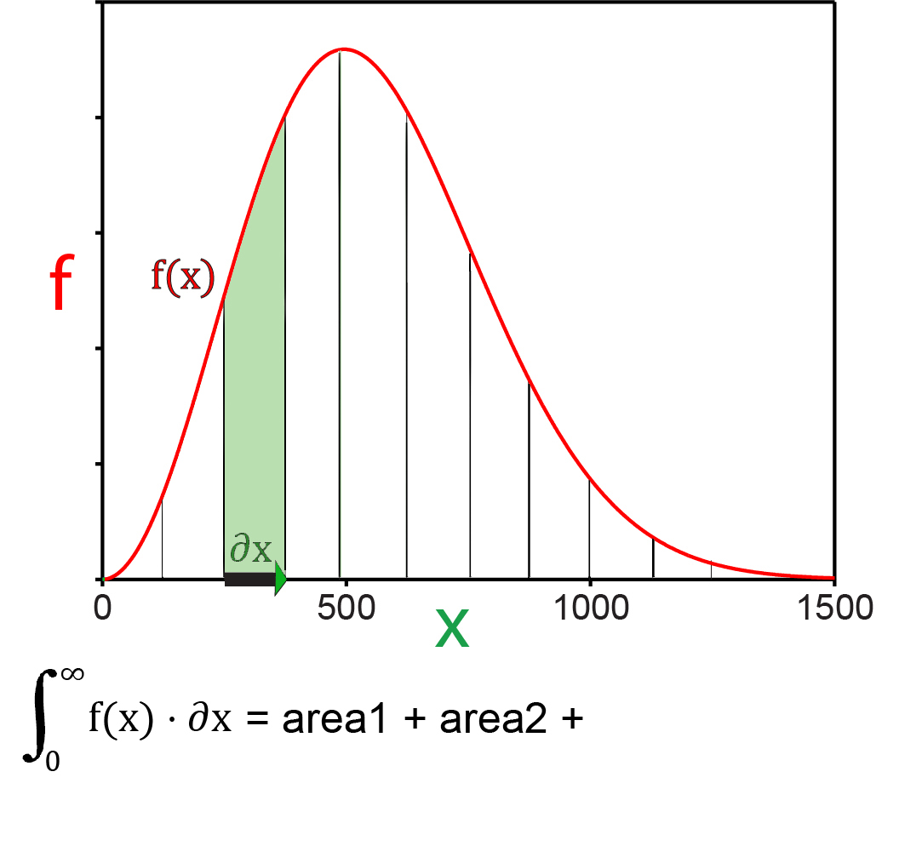
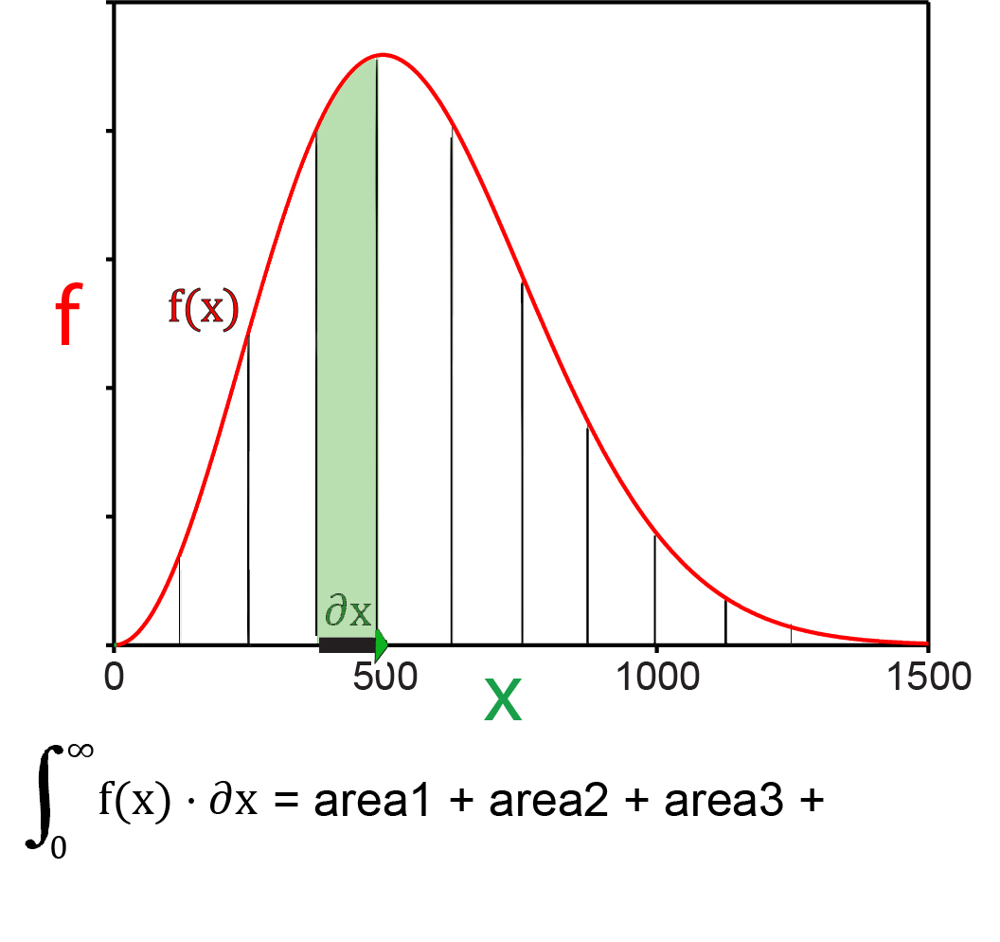
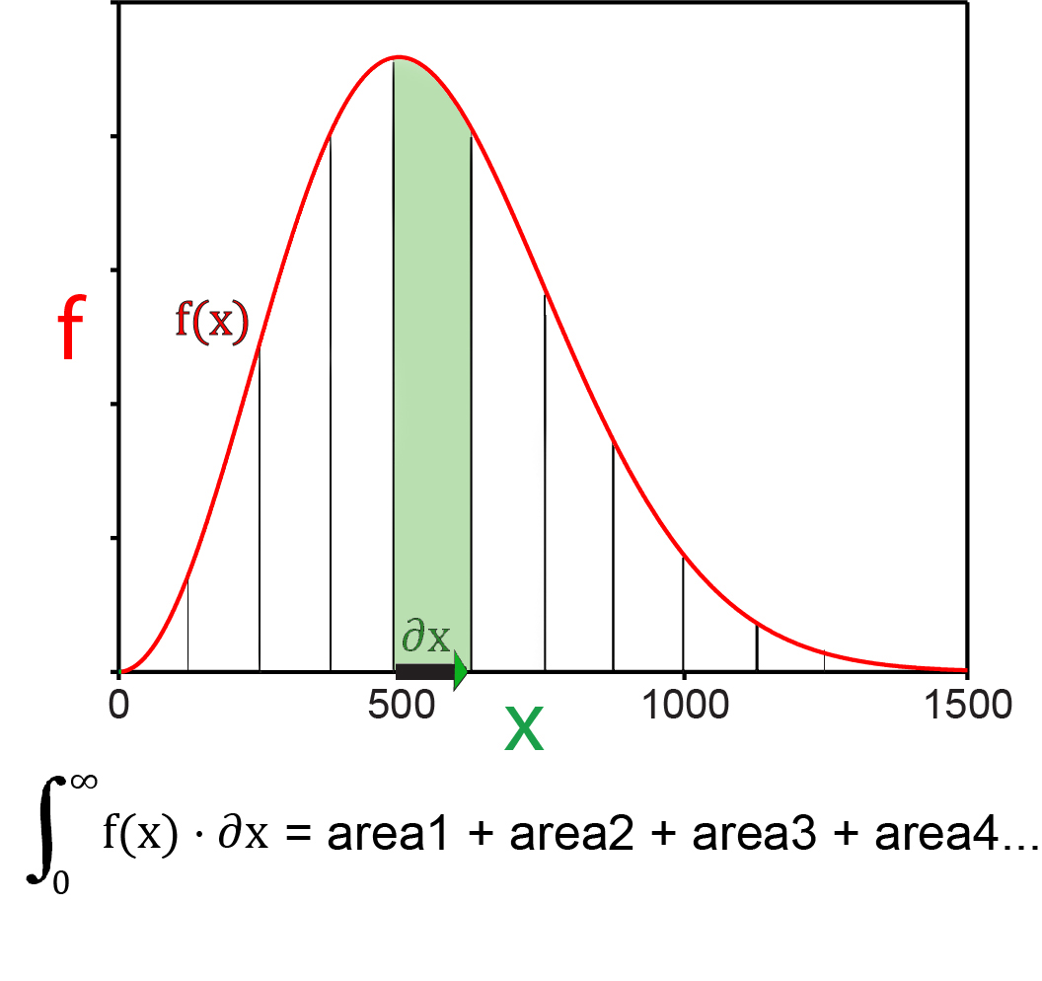
1D to 3D Integrals

Slide 2
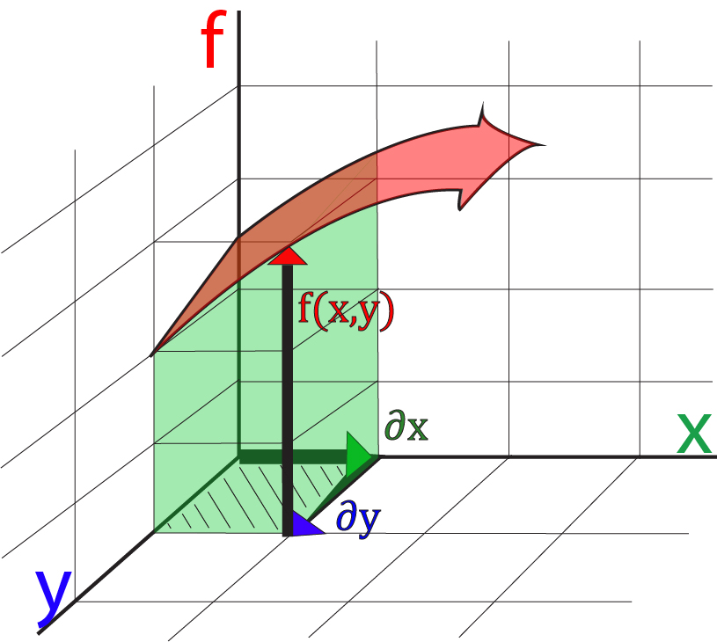
2D Integrals
$$\int_{0}^{∞}{\int_{0}^{∞}{f(x,y)⋅∂x⋅∂y}}$$

Slide 3
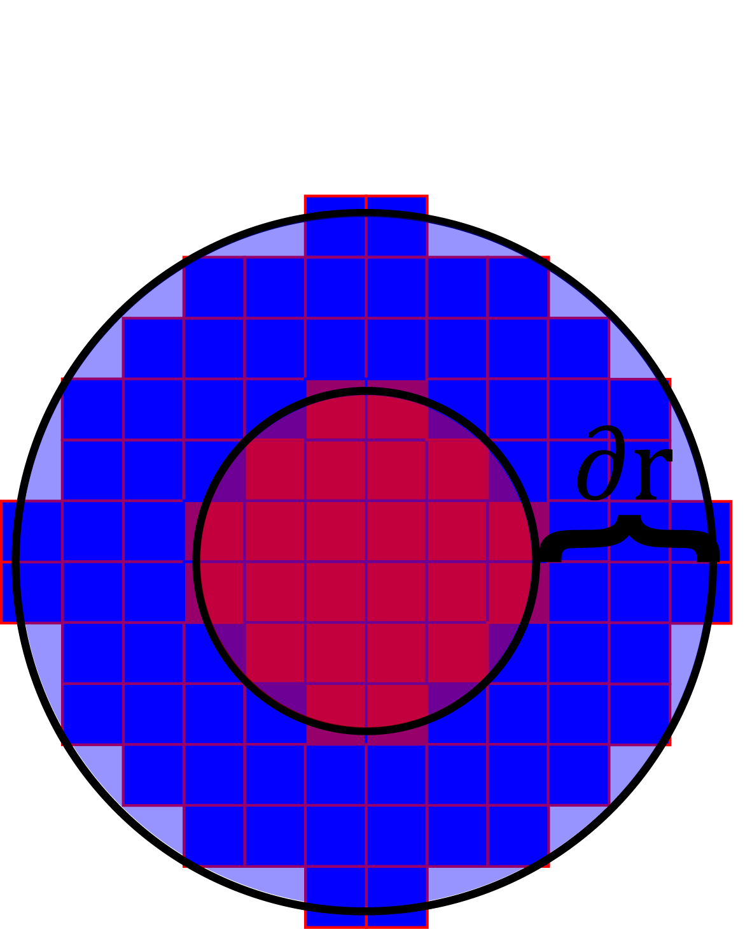
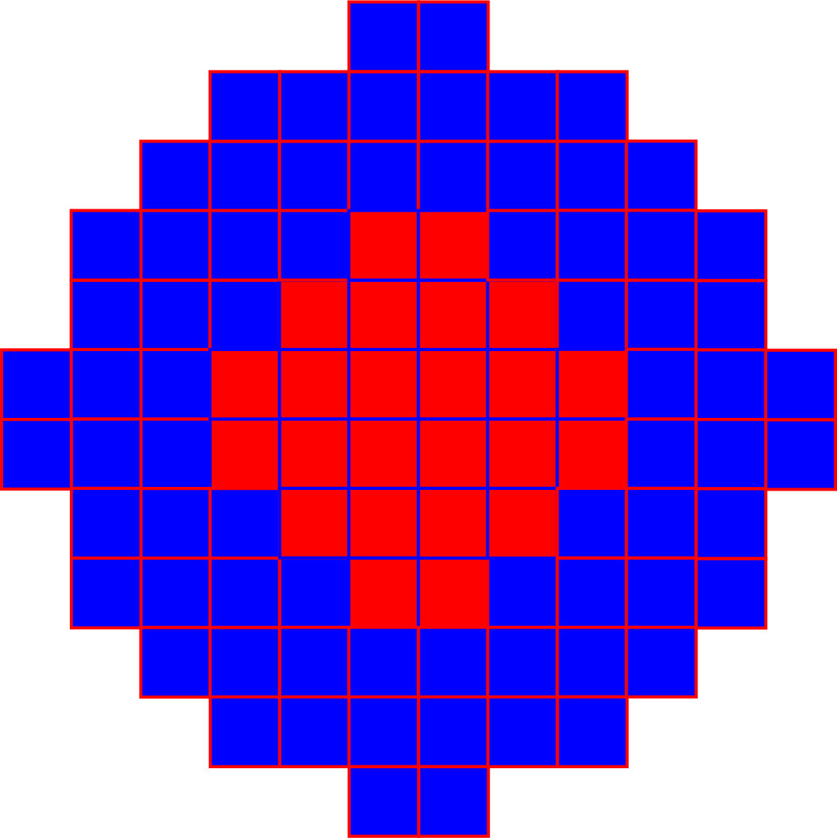
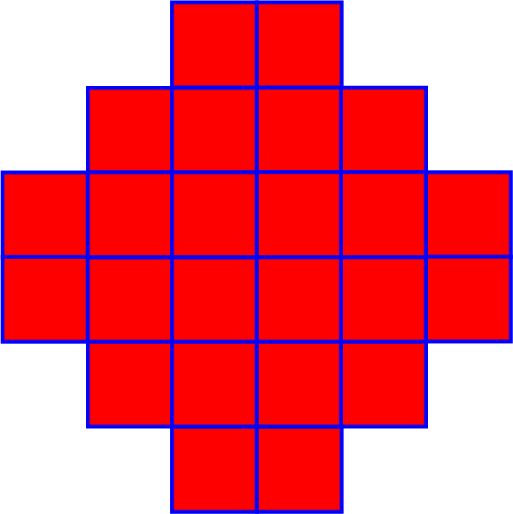
2D Integrals
$$\int_{−∞}^{∞}{\int_{−∞}^{∞}{f(x,y)⋅∂x⋅∂y}}$$
The circumference of a circle is $2πr$.
The thickness of the disk is $∂$r.
$$\int_{−∞}^{∞}{f\left(r\right)∙2πr∙∂r}$$

Slide 4
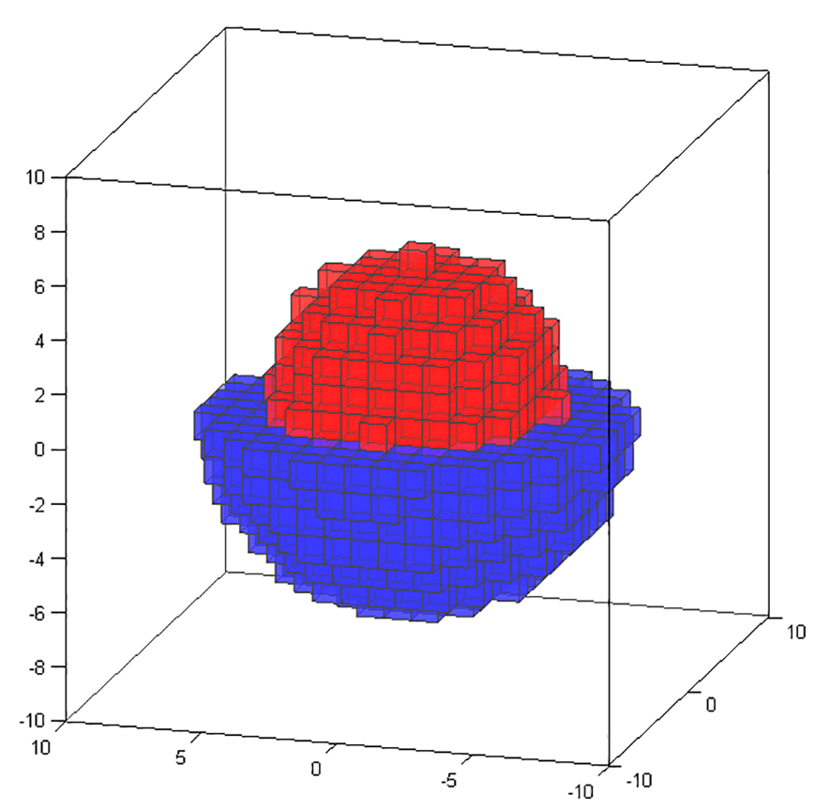
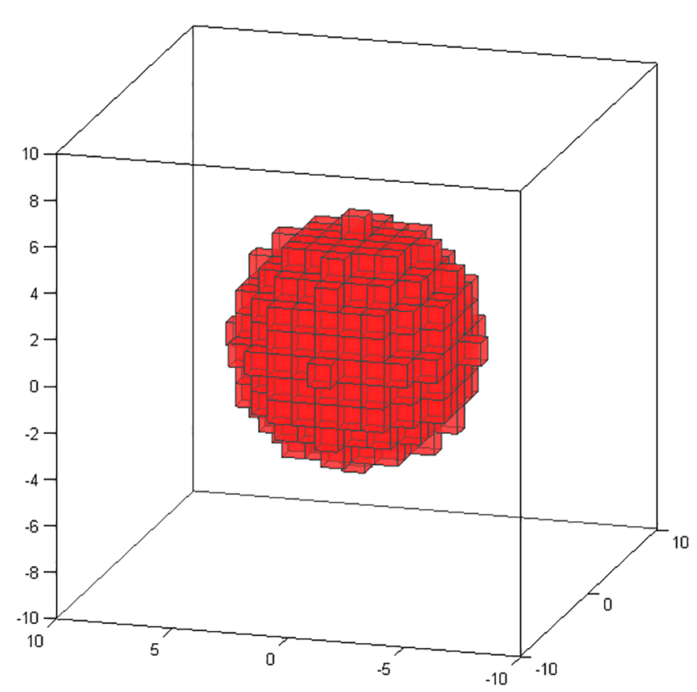
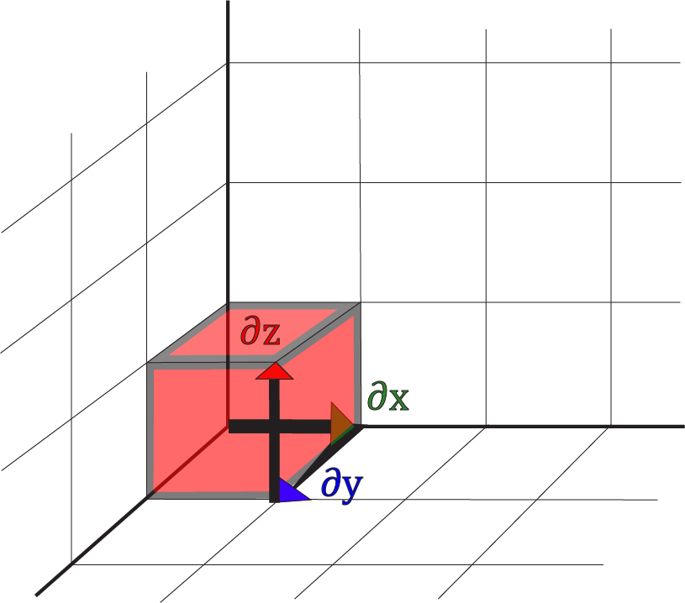
3D Integrals
$$\int_{−∞}^{∞}{\int_{−∞}^{∞}{\int_{−∞}^{∞}{f(x,y,z)⋅∂x⋅∂y⋅∂z}}}$$
$$∂r$$

Slide 5
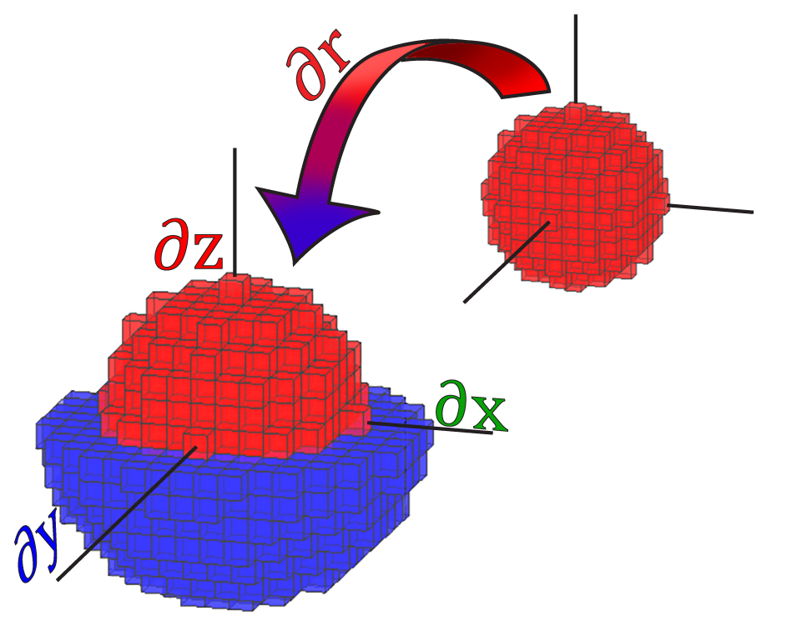
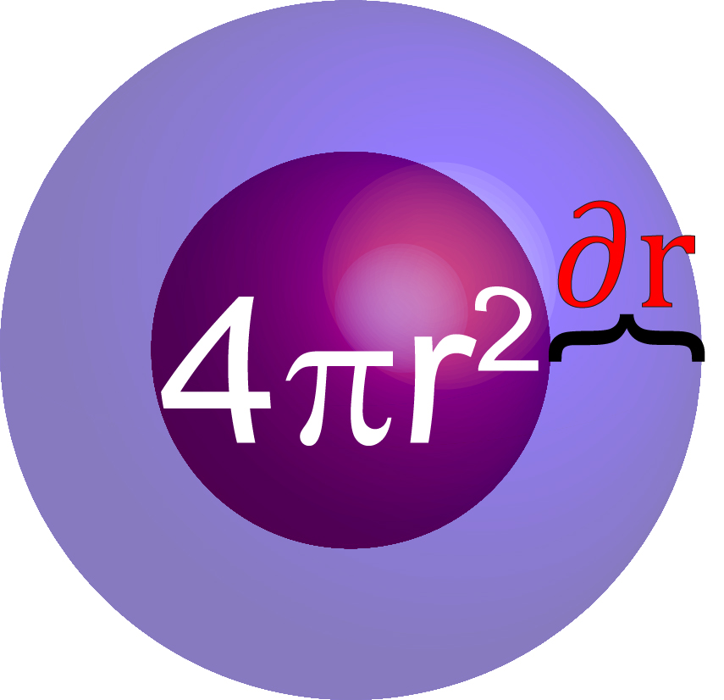
3D Integrals
$$\int_{−∞}^{∞}{\int_{−∞}^{∞}{\int_{−∞}^{∞}{f(x,y,z)⋅∂x⋅∂y⋅∂z}}}$$
The surface area of a sphere is $4πr^{2}.$
The thickness of the shell is $∂$r.
$$\int_{−∞}^{∞}{f\left(r\right)∙4πr^{2}∙∂r}$$

